Slide 1
Disaster Management
Fire Disasters
Sai Teja Reddy Moolamalla
201564086

Slide 2
Fire Escape Simulator
A simple application which simulates a fire disaster in a map of a building.
Can provide live planning of escape route for multiple people trapped in the building.
The backend algorithm considers alternate escape routes to prevent overcrowding near some particular exit.
Dynamic rerouting if fire unexpectedly blocks exits predetermined to be safe.

Slide 3
Fire Escape Simulator
Takes input a grid of the building and positions of people and fire to start the simulation.
Clean and understandable UI made for the planned route.
Simulator might choose longer paths to the exit to prevent overcrowding at one exit.

Slide 4
Demo

Slide 5
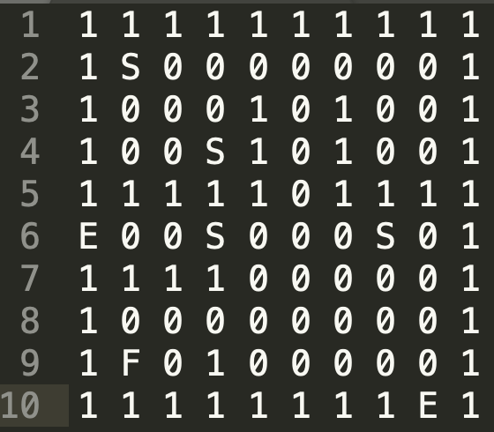
Input Grid
1 - Wall
E - Exit
F - Fire
S - Person

Slide 6
1 - Wall
E - Exit
F - Fire
1 - Person

Slide 7




Wall
Exit
Fire
Person

Slide 8
Thanks!

